Slide 1
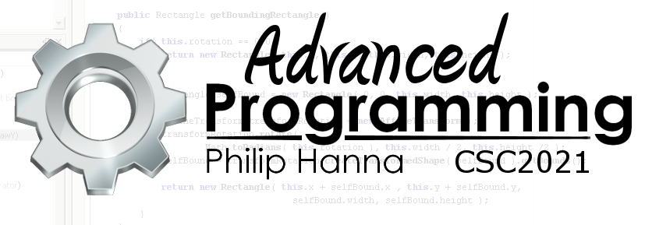
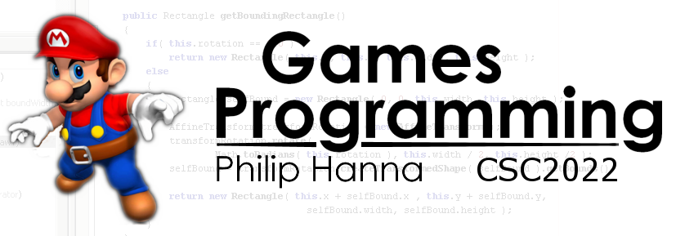
Introduction to C++
Important introductory slices of C++ for Java and C# programmers.
Part 4: Summary

Slide 2



C++ Summary

Slide 3

C++ has considerably evolved and developed over its thirty year existence. It can be used to write low-level code or develop large enterprise solutions.
This means the language is large and complex. Arguably, thirty years of evolution have also introduced language aspects that are not syntactically as refined as they could be.

Slide 4

Relative to C# or Java, C++ is often viewed as a somewhat less friendly and more dangerous language that will ‘bite’ if you do something wrong.
There is some truth to this view. It will be important to understand your code at a deeper level than in previous modules.
Notes:
Bjarne Stroustrup, the creator of C++, said:
‘C makes it easy to shoot yourself in the foot; C++ makes it harder, but when you do it blows your whole leg off’
Ok, he clarifies that he was referring to the richer set of language features (which many languages richer than C also possess).

Slide 5

C++ is a powerful language that can be used to write complex and fast code.
Understanding how C++ accomplishes this will improve your programming ability in all languages.

